Slide 1
Soar-RL: Reinforcement Learning and Soar
Shelley Nason

Slide 2
Reinforcement Learning
Reinforcement learning:
Learning how to act so as to maximize the expected cumulative value of a (numeric) reward signal
In Soar terminology, RL learns operator comparison knowledge

Slide 3
A learning method for low-knowledge situations
Non-explanation-based, trial and error learning – RL does not require any model of operator effects to improve action choice.
Additional requirement – rewards.
Therefore RL component should be automatic and general-purpose.
Ultimately avoid
  Task-specific hand-coding of features
  Hand-decomposed task or reward structure
  Programmer tweaking of learning parameters
  And so on

Slide 4
Q-values
Q(s,a): the expected discounted sum of future rewards, given that the agent takes action a from state s, and follows a particular policy thereafter
Given optimal Q-function, selecting action with highest Q-value at each state yields optimal policy
reward
λ*reward
action
state
action
state
action
state
action
Etc.

Slide 5
Representing the Q-function
In Soar-RL, Q-function stored as productions, testing state and operator, and asserting numeric preferences.
Sp{RL-rule
(state <s> ^operator <o> +)
…
→
(<s> ^operator <o> = 0.33231)}
During decision phase, the Q-value of an operator O is taken to be the sum of all numeric preferences asserted for O.

Slide 6
Learning
Q-value represented as concatenation:
StateXAction → Set of Features → Value
Q-learning: Move the value of Q(s_{t},a_{t})
toward r_{t} + γ*max_{a} Q(s_{t+1},a).
Bootstrapping: Update the prediction at one step using the prediction at the next step.
Automatic Feature Generation
Q-learning
(updating parameters of linear function)
reward
state
action
state

Slide 7
Current Work-
Automatic Feature generation
Constructing rule conditions with which to associate values
Since values stored with RL rules, some RL rule must fire for every state-action pair for bootstrapping to work
Sufficient distinctions required that agent will not confuse state-action pairs with significantly different Q-values
Want rules that take advantage of opportunities for generalization

Slide 8
Waterjug Task-
A reasonable set of rules
One for each state-action pair, for instance-
Sp {RL-0003
:rl
(state <s> ^jug <j1>
^jug <j2>
^operator <o> +)
(<j1> ^volume 5 ^contents 5)
(<j2> ^volume 3 ^contents 0)
(<o> ^name fill ^jug <j2>)
→
(<s> ^operator <o> = 0)}
46 RL rules
0,0
0,0
5,0
5,0
0,3
0,3
2,3
2,3
3,0
5,3
3,0
5,3
2,0
2,0
3,3
3,3
0,2
0,2
5,1
+1
5,1
5,2
-1
5,2
0,1
0,1
4,3
4,3
1,0
1,0
1,3
4,0
1,3
4,0

Slide 9
How to generate rule automatically?
Rule could be built from WM, for instance-
sp {RL-1
:rl
(state <s> ^name waterjug ^jug <j1>
^jug <j2> ^operator <o4> +
^superstate nil ^type state)
(<j1> ^contents 0 ^free 5 ^volume 5)
(<j2> ^contents 0 ^free 3 ^volume 3)
(<o4> ^name fill ^jug <j2>)
→
(<s> ^operator <o4> = 0)}

Slide 10
But we want generalization…
0,0
5,0
0,3
2,3
3,0
5,3
2,0
3,3
0,2
5,1
+1
5,2
0,1
-1
4,3
1,0
4,0
1,3

Slide 11
Adaptive representations
System constructs feature set so that more distinctions in parts of state-action space requiring more distinctions.
Specific-to-general:
Collect instances and cluster according to similar values.
General-to-specific:
Add distinctions when area with single representation appears to contain multiple values.

Slide 12
General-to-specific
Our most general rules
Rules made from operator proposals
Sp {RL-1
:rl
(state <s1> ^name waterjug ^jug <j1> ^operator <o1> +)
(<j1> ^free 3)
(<o1> ^jug <j1> ^name fill)
-->
(<s1> ^operator <o1> = 0)}
Only generated when no rule fires for the selected operator

Slide 13
Specialization –
Example of overgeneral representation
0,0
5,0
0,3
2,3
3,0
5,3
2,0
3,3
0,2
5,1
+1
5,2
0,1
-1
4,3
1,0
4,0
1,3
If jug has contents 3, then pour from jug into other jug.

Slide 14
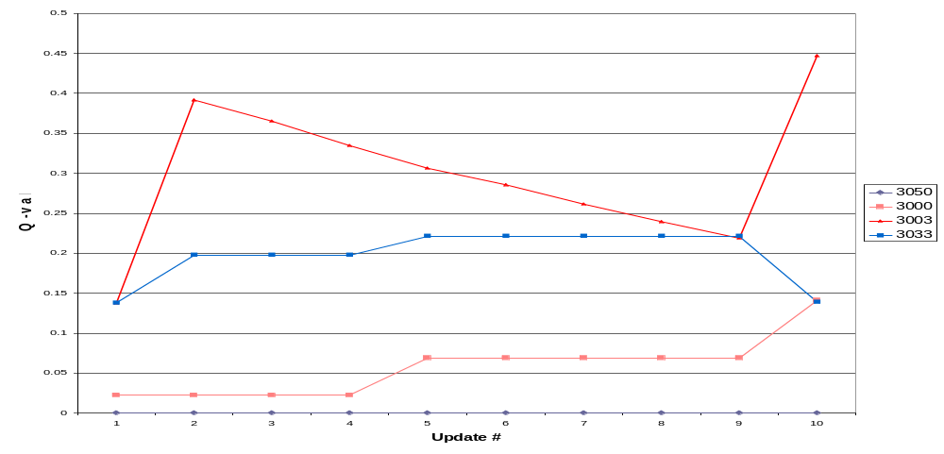
Predicted Q-values at the state (3,0)
Goal achieved
Goal achieved

Slide 15
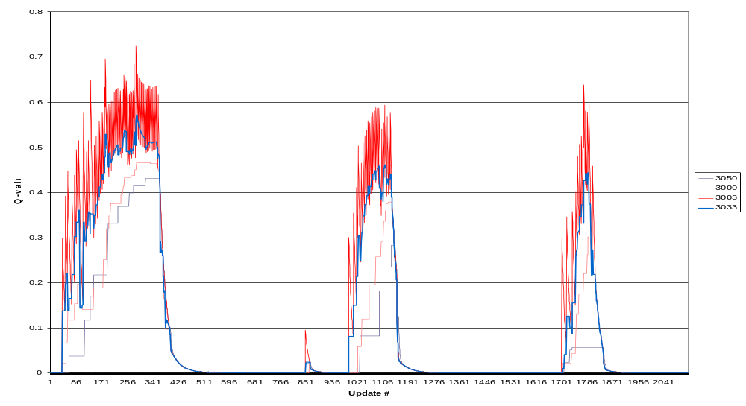
Predicted Q-value for state (3,0)

Slide 16
How to fix – Add following rule
0,0
0,0
If there is a jug with volume 3 and contents 3, pour this jug into the other jug.
5,0
5,0
0,3
0,3
2,3
2,3
3,0
3,0
5,3
5,3
2,0
2,0
3,3
3,3
0,2
0,2
5,1
5,1
5,2
5,2
0,1
0,1
4,3
4,3
1,0
1,0
1,3
4,0
1,3
4,0

Slide 17
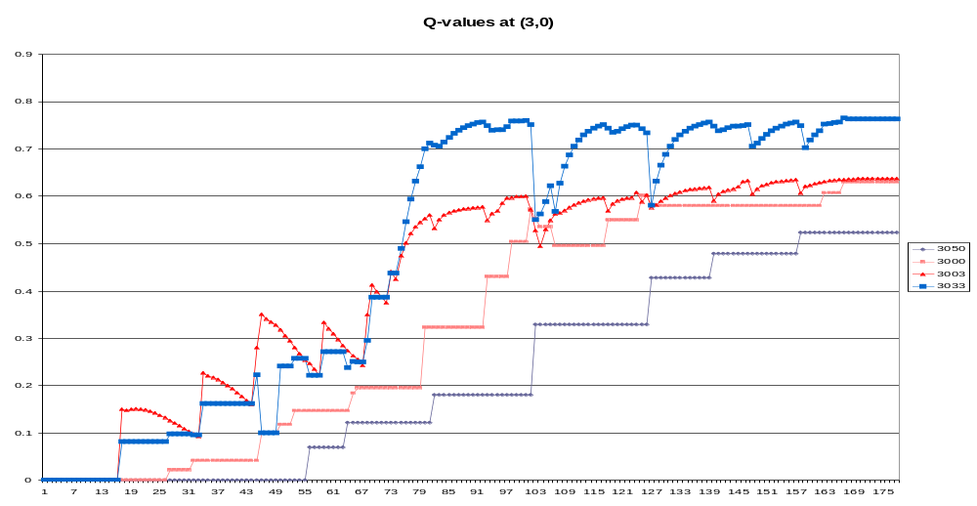
How to fix – Add following rule
If there is a jug with volume 3 and contents 3, pour this jug into the other jug.

Slide 18
Designing a specialization procedure
How to decide whether to specialize a given rule.
Given that we have chosen to specialize a rule, what conditions should we add to the rule?
(optional) In what, if any, cases should a rule be eliminated?

Slide 19
Question 2 (What conditions to add to a rule) – Proposed Answer
Trying an activation-based scheme.
  When an (instantiated) rule R decides to specialize, it finds the most activated WME,
  w = (ID ATTR VALUE).
  Traces upward through WM, to find a shortest path from ID to some identifier in the rule’s instantiation
  w and the WMEs in the trace add themselves to the conditions in R to form a new rule R’
  If R’ is not a duplicate of some existing rule, R’ is added to the Rete (without removing R).

Slide 20
Question 1 (Should a given rule be specialized) – Proposed answer
Track weights (numeric preferences) of rules.
Weights should converge when rules sufficient, so stop specializing when weights stop moving.

Slide 21
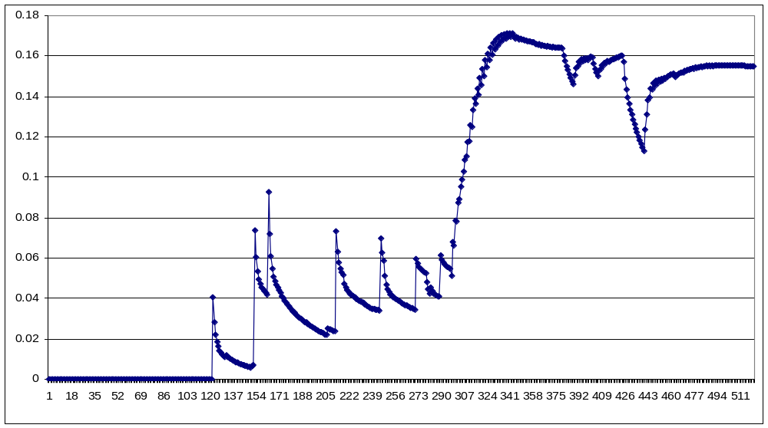
Tracking weights of rule RL-3

Slide 22
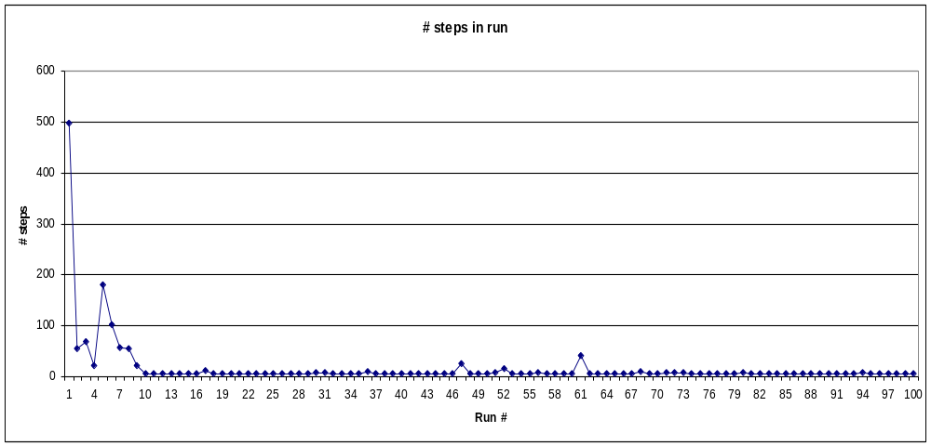
# steps in run

Slide 23
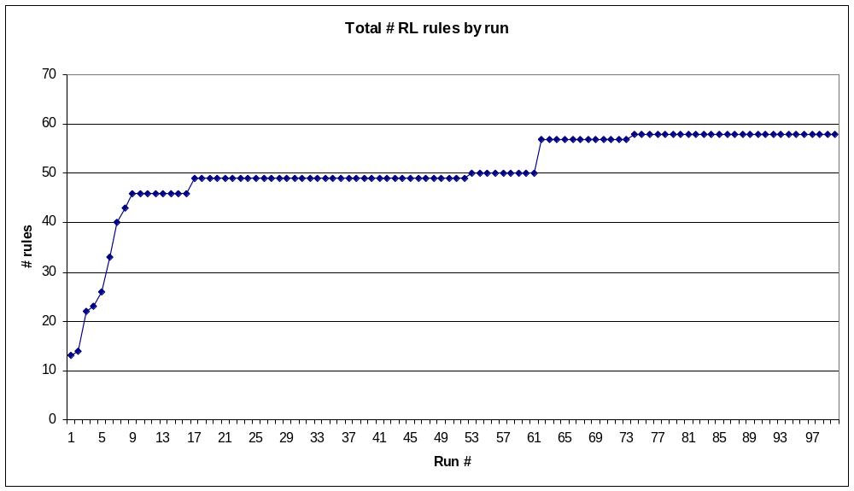
# rules

Slide 24
Conclusions
Nuggets – Did work (at least on Waterjug)
That is, came to follow the optimal policy.
Coal – Makes too many rules
  Specializes rules that don’t need specialization.
  Specializations not always useful, since chosen heuristically
  Will try to explain non-determinism by making rules.

